Slide 1
FEAF/TBM Alignment Tool
Quick Painless Automated
Developed by Patrick Stingley
Bureau of Land Management
January 12, 2022
Patrick Stingley
Pstingley@BLM.gov
(202) 815-3550

Slide 2
Situation
The Federal Government has mandated alignment of IT assets with the Technology Business Management (TBM) taxonomy in FY2022.
This tool automates the process.
Patrick Stingley
Pstingley@BLM.gov
(202) 815-3550
Notes:
While there is a push for TBM in the government the Federal Enterprise Architecture Framework (FEAF) hasn’t been updated in a decade.
All Agencies have automated inventories which are sent to DHS/CDM.
Despite the FEAF being obsolescent, Agencies have a significant investment in it.
This tool was designed to leverage that.
Agencies now have an unfortunate dual-reporting requirement.
This tool mitigates that.

Slide 3
FEAF/TBM Alignment Tool Partners
Many thanks to FTIM CoP and others in GSA’s Office of Government-wide Policy (OGP), for working with me on this tool and for working with the TBM council on our behalf to reconcile with the TBM taxonomy.
Patrick Stingley
Pstingley@BLM.gov
(202) 815-3550

Slide 4
Procedure
Get the data
1
Process the data
2
Paste the data
3
Patrick Stingley
Pstingley@BLM.gov
(202) 815-3550

Slide 5
File Location:
IT Product to TBM Taxonomy Mapping Tool - E-Government Community - MAX Federal Community
Patrick Stingley
Pstingley@BLM.gov
(202) 815-3550

Slide 6
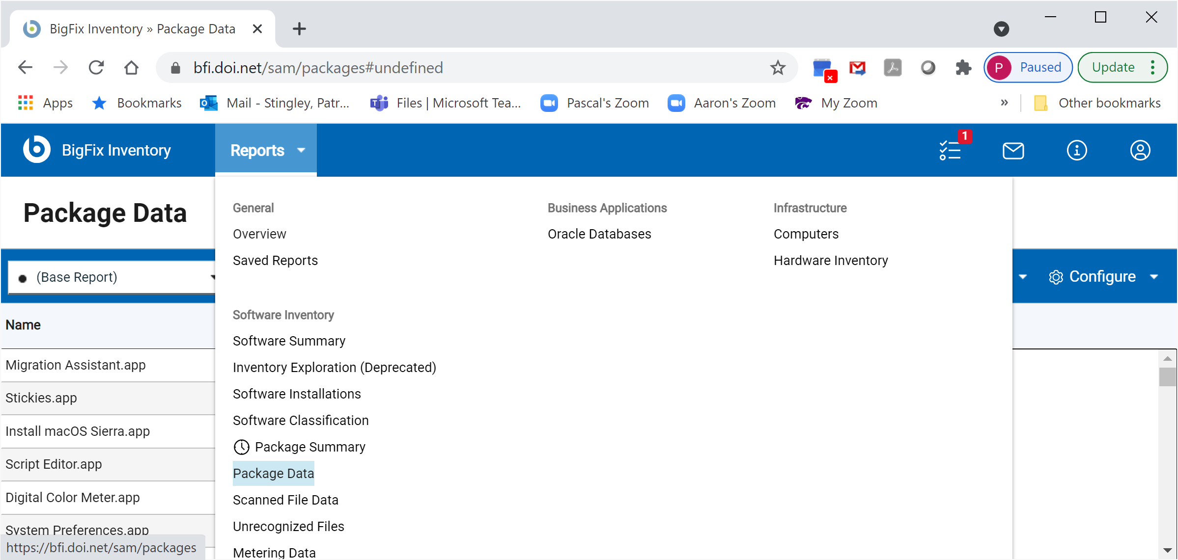
Step 1
Get the data (Choose Package Data)
Patrick Stingley
Pstingley@BLM.gov
(202) 815-3550
Notes:
Any tool that can provide the product name will work. Product name and version are preferred. The example is from BigFix, but inventory data from other tools can work.
In BigFix (BFI interface), go into Reports and select Package Data

Slide 7
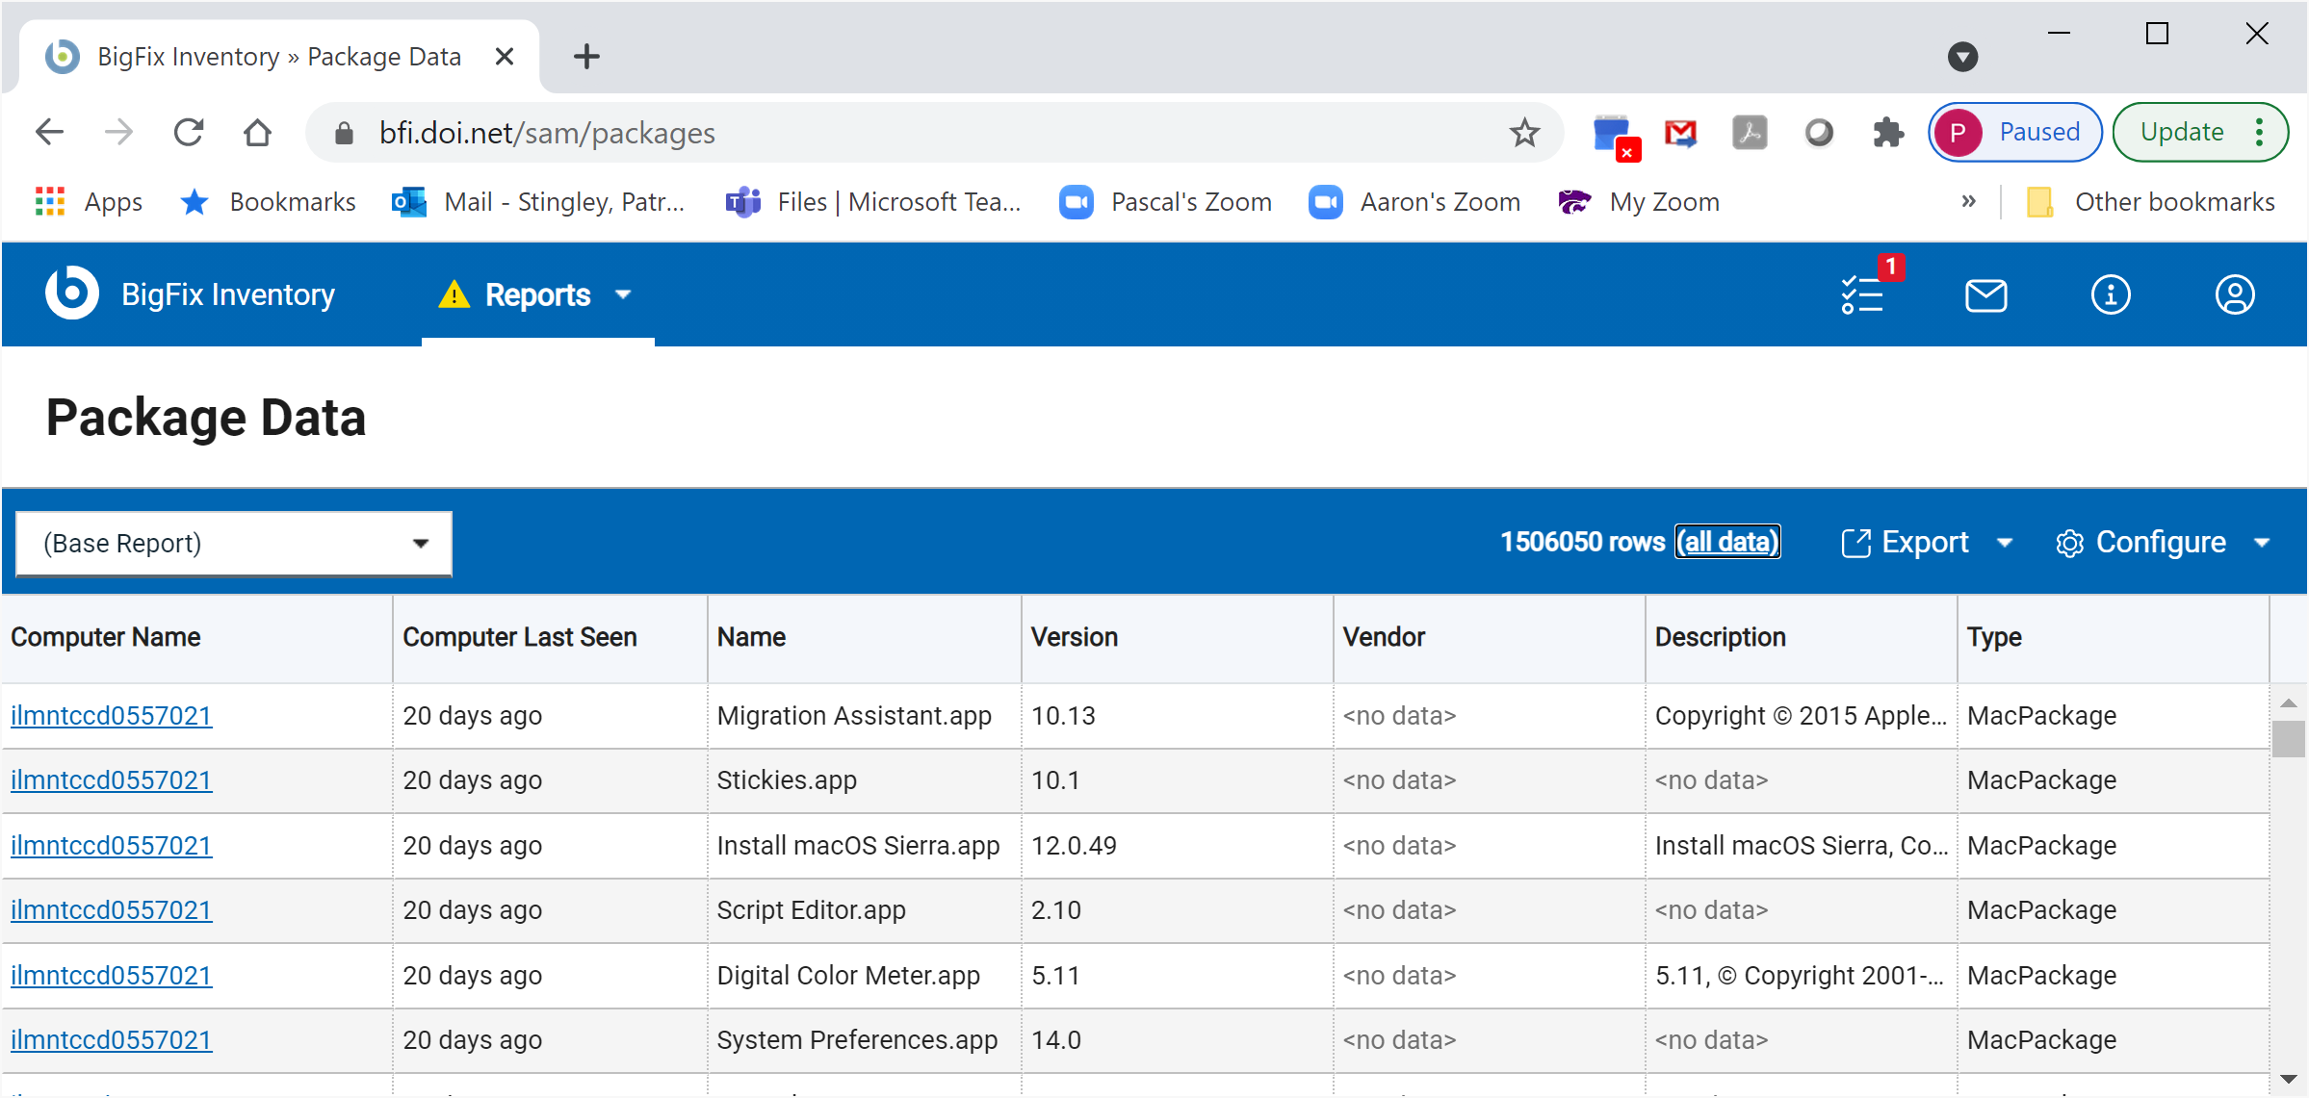
Step 1
Get the data (Choose “all_data” to modify the Report)
Patrick Stingley
Pstingley@BLM.gov
(202) 815-3550
Notes:
This is too much data, so go into (all data) to remove some of it.

Slide 8
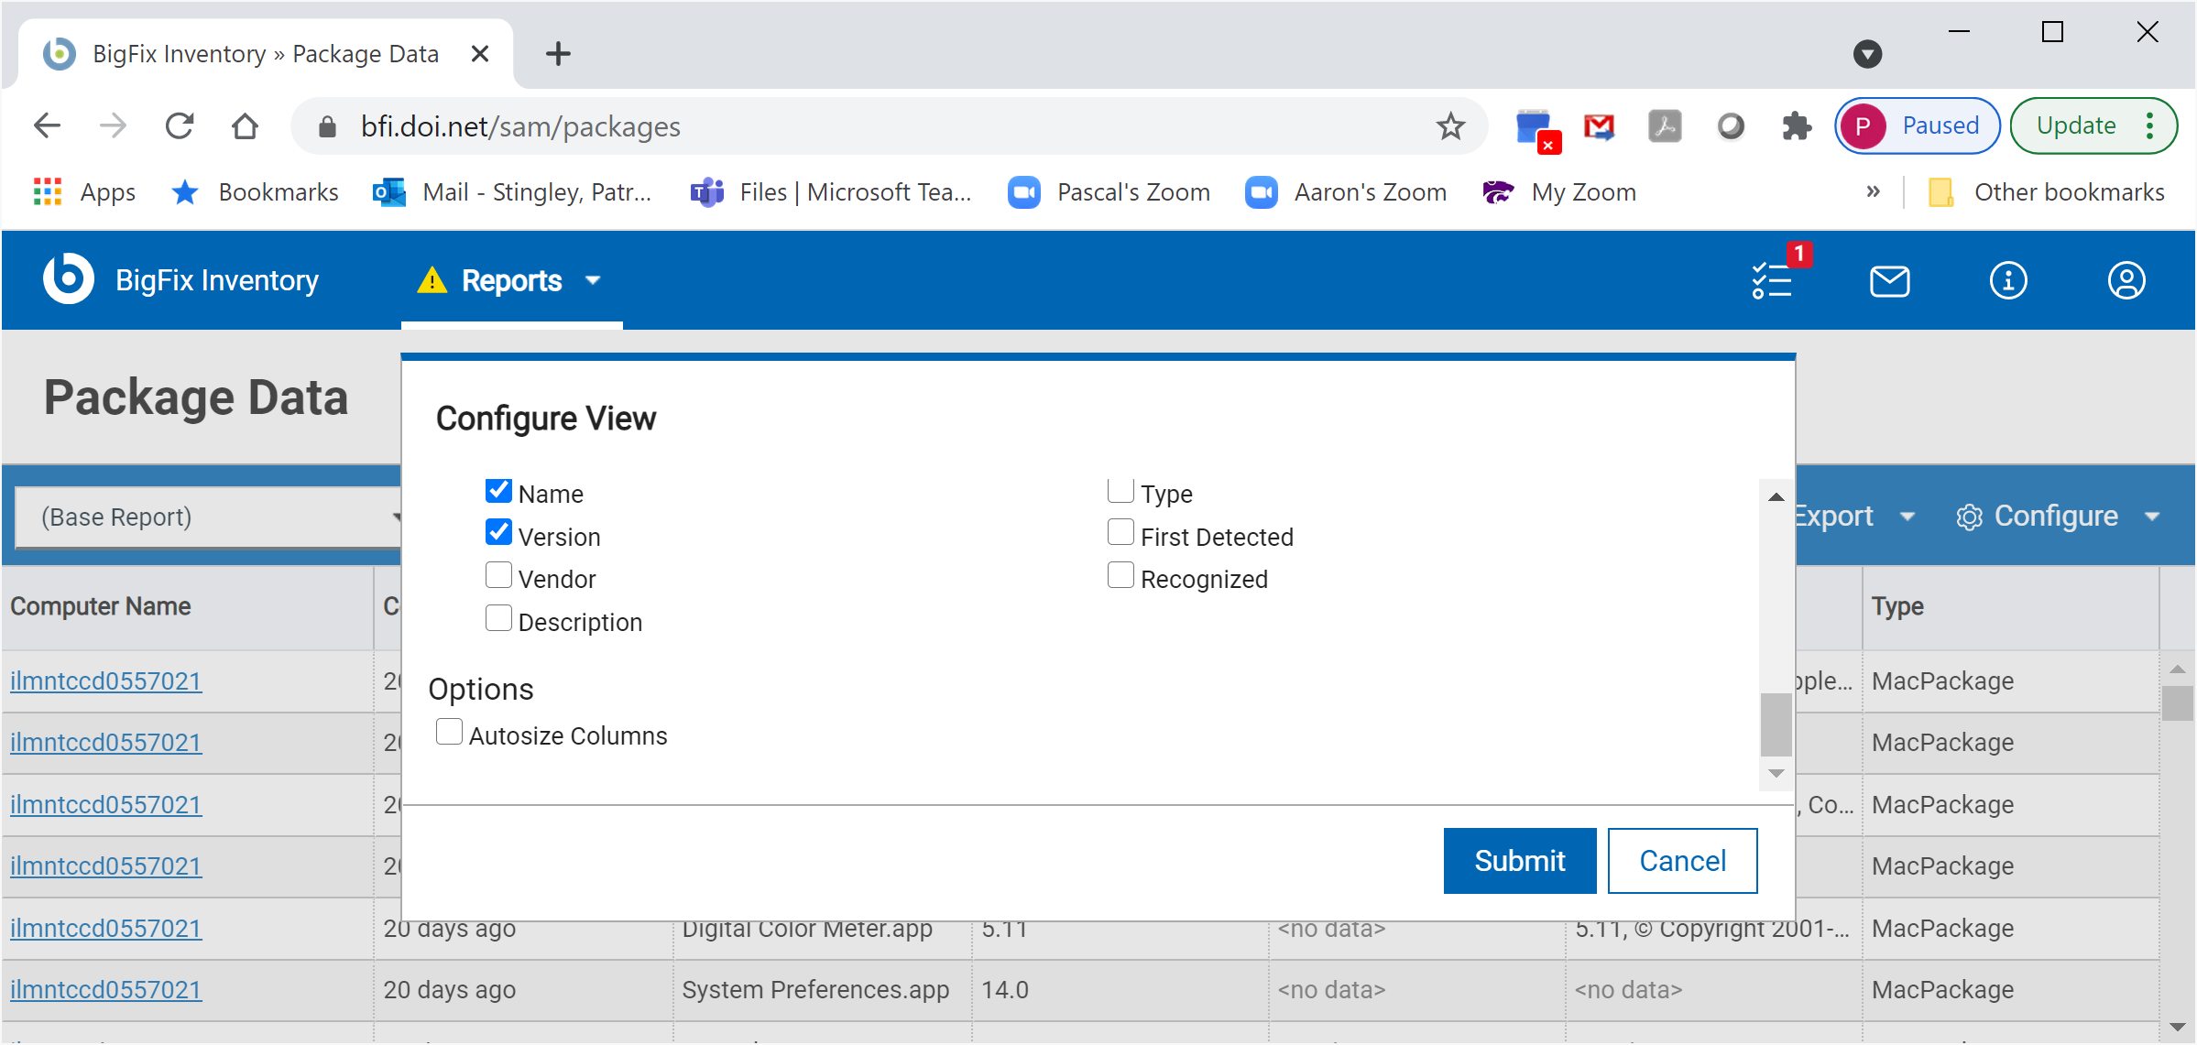
Step 1
Get the Data: (Keeping Product Name and Version.)
Patrick Stingley
Pstingley@BLM.gov
(202) 815-3550
Notes:
De-select everything except Name and Version

Slide 9
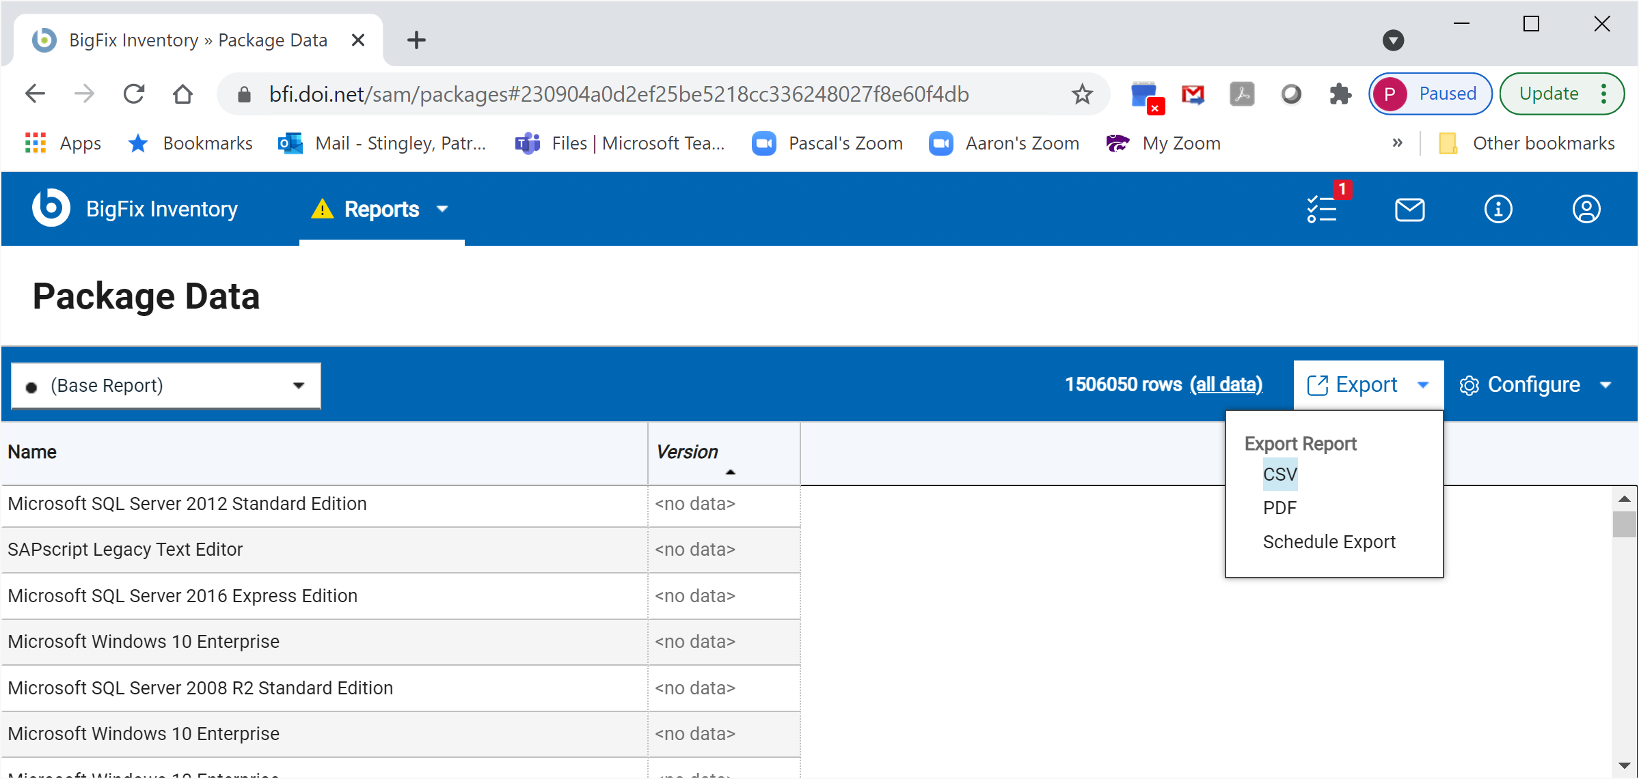
Step 1
Get the data (Export as .csv)
Patrick Stingley
Pstingley@BLM.gov
(202) 815-3550
Notes:
Export this report as a Comma Separated Value (.csv) file

Slide 10
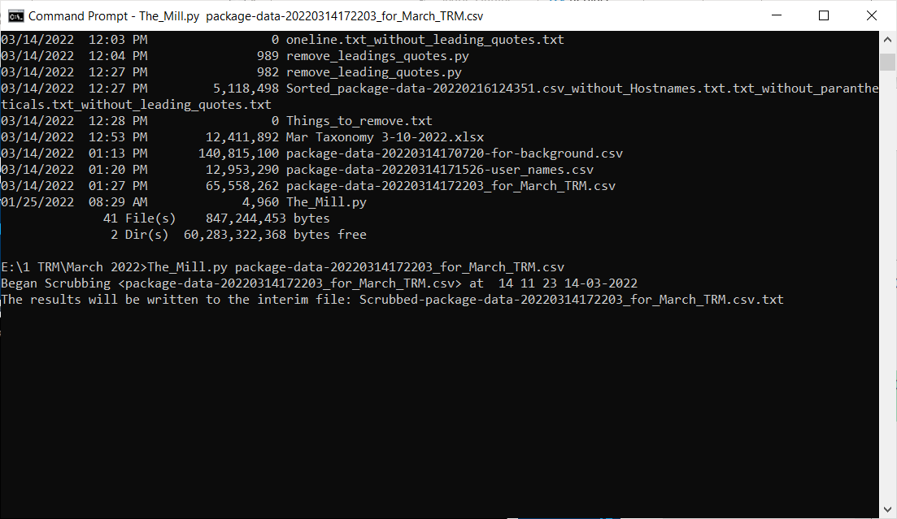
Step 2
Python Cleans, Sorts & Counts the Data
This also makes it small enough for Excel
Patrick Stingley
Pstingley@BLM.gov
(202) 815-3550
Notes:
Open a command window.
Type:
Process_BFI_3_23_2021.py followed by the name of the .csv file you just created.
The name is “Process BFI” because it processes data from the BFI interface of BigFix. These should work with data from any inventory system, so long as they can produce a .csv file with the product and version for all software.
I have a program that can clean up data if yours needs to be cleaned first.

Slide 11
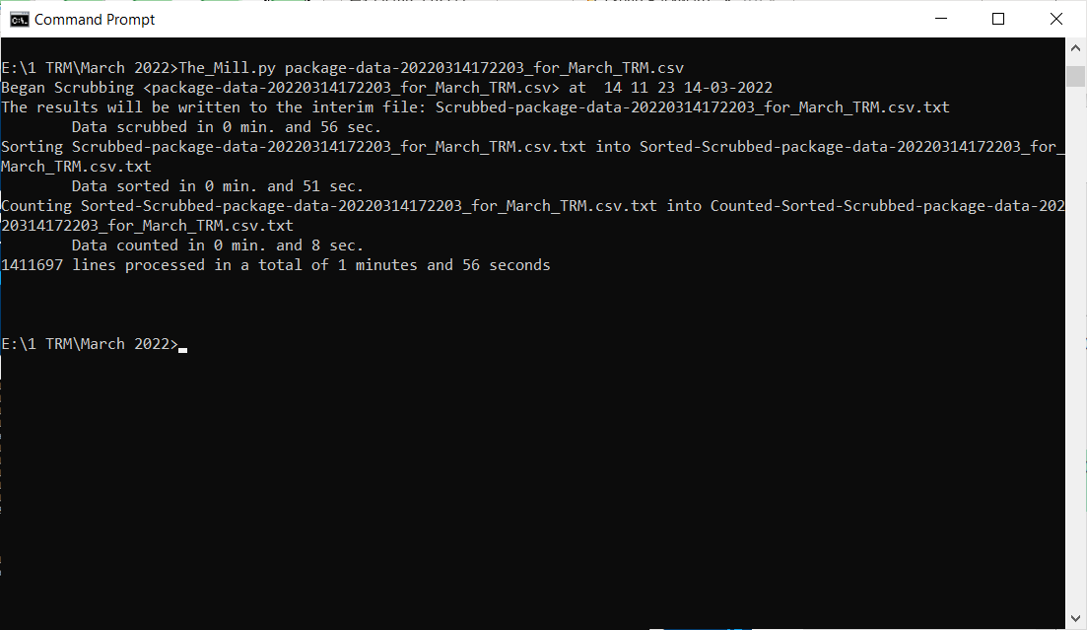
Step 2
Sorting and Counting took 33 Seconds
Patrick Stingley
Pstingley@BLM.gov
(202) 815-3550
Notes:
The program reports progress as it works:

Slide 12
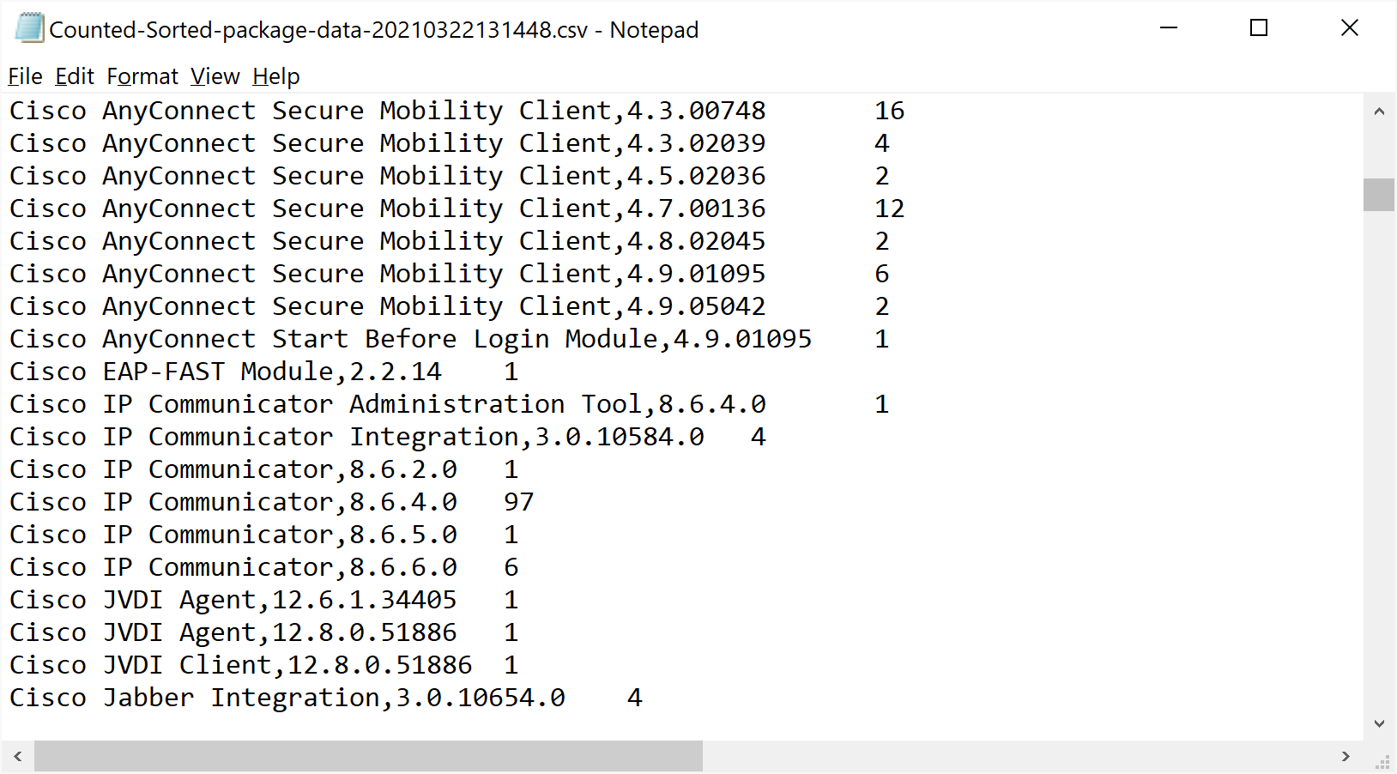
Step 2
Open the output file in Notepad
Patrick Stingley
Pstingley@BLM.gov
(202) 815-3550
Notes:
It will tell you the name of the text file it is creating. Open the output file with Notepad.

Slide 13
Step 3
Copy the Data <CTRL><a> then <CRL><c>
Patrick Stingley
Pstingley@BLM.gov
(202) 815-3550
Notes:
Select all (<CTRL>+<A>) and Copy (<CTRL>+c), then paste into the Products tab in the spreadsheet.

Slide 14
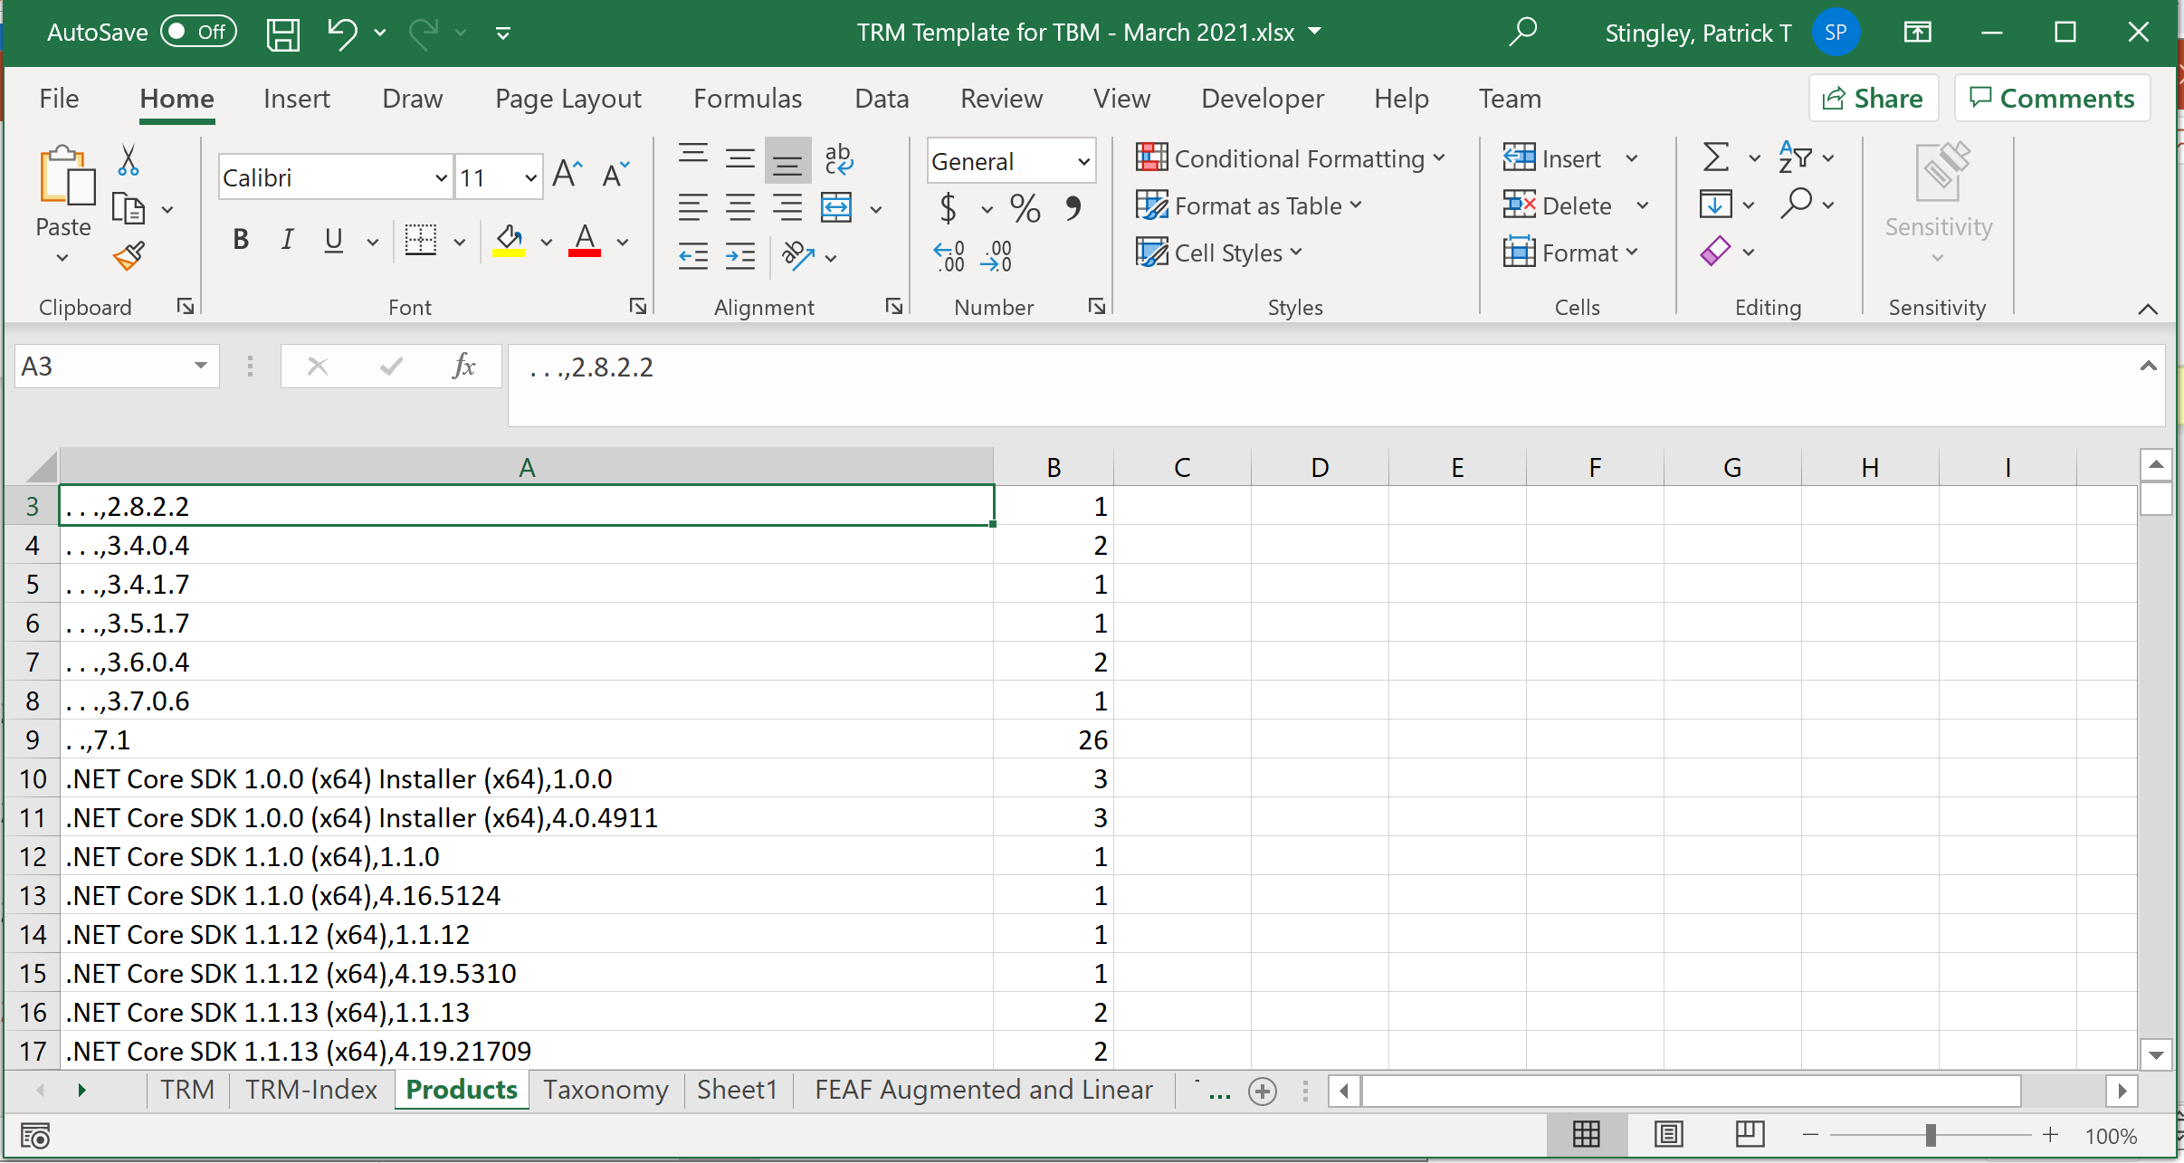
Step 3
Paste the Data over the Products Sheet
Patrick Stingley
Pstingley@BLM.gov
(202) 815-3550
Notes:
Now, you have a counted inventory of your software

Slide 15
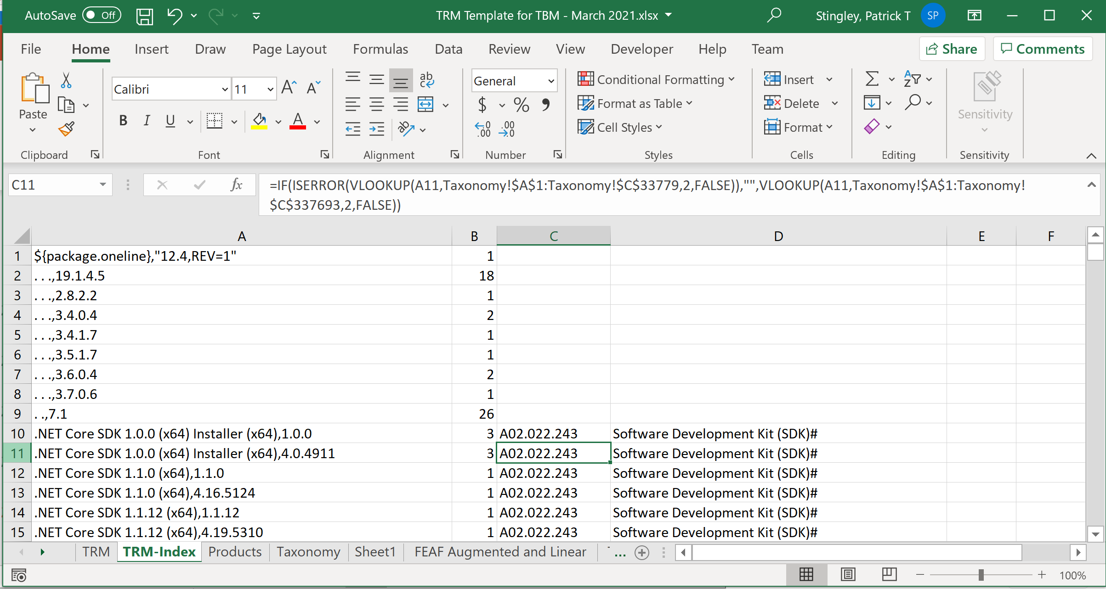
Step 3
The macros will update the other sheets
Patrick Stingley
Pstingley@BLM.gov
(202) 815-3550
Notes:
Now, the macros do all the work.
(You’re done!)

Slide 16
Step 3
Copy the TRM-Index and Paste Over the TRM Sheet as literal values (This allows the TRM to be sorted)
Patrick Stingley
Pstingley@BLM.gov
(202) 815-3550
Notes:
The macros match the products you pasted into the Products tab against the alignment of these products with the FEAF, located in the Taxonomy tab.

Slide 17
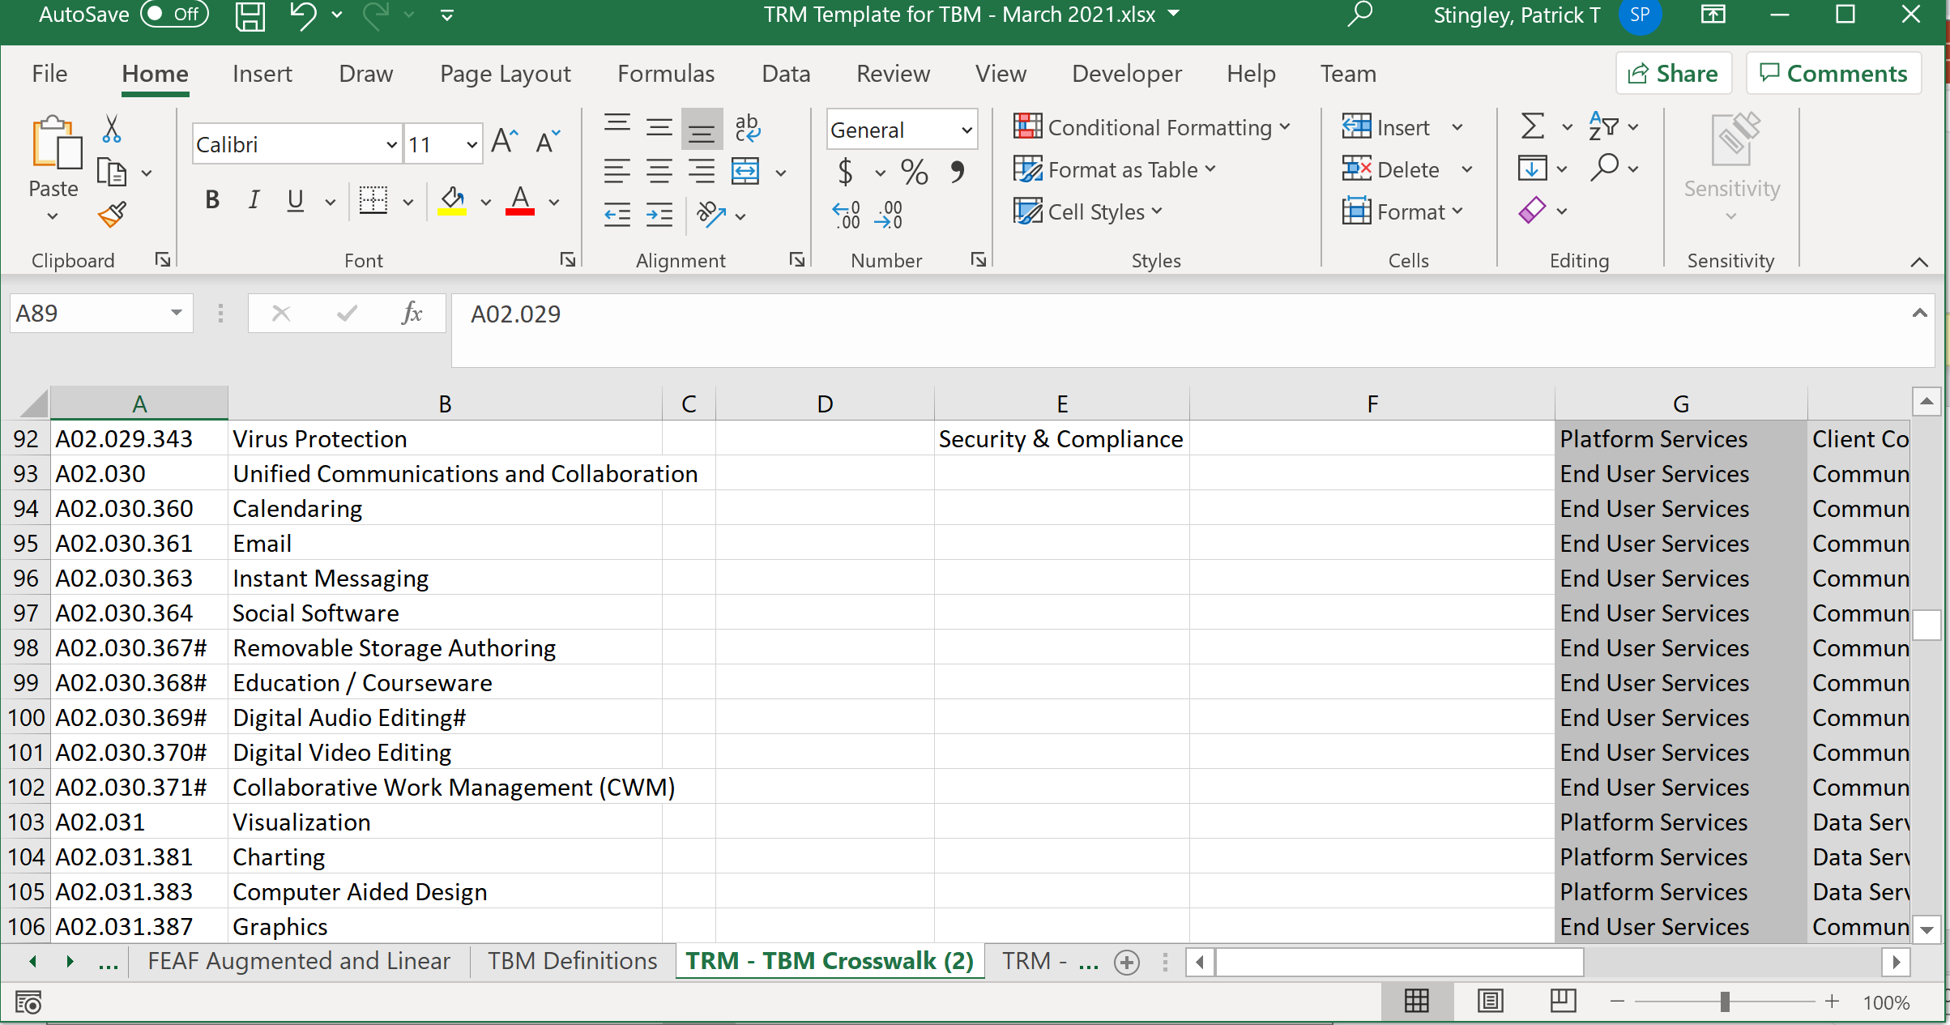
Step 3
“TRM – TBM Crosswalk” Correlates the Models
Patrick Stingley
Pstingley@BLM.gov
(202) 815-3550
Notes:
The TRM – TBM Crosswalk tab contains the mapping between the FEAF categories and the TBM categories.

Slide 18
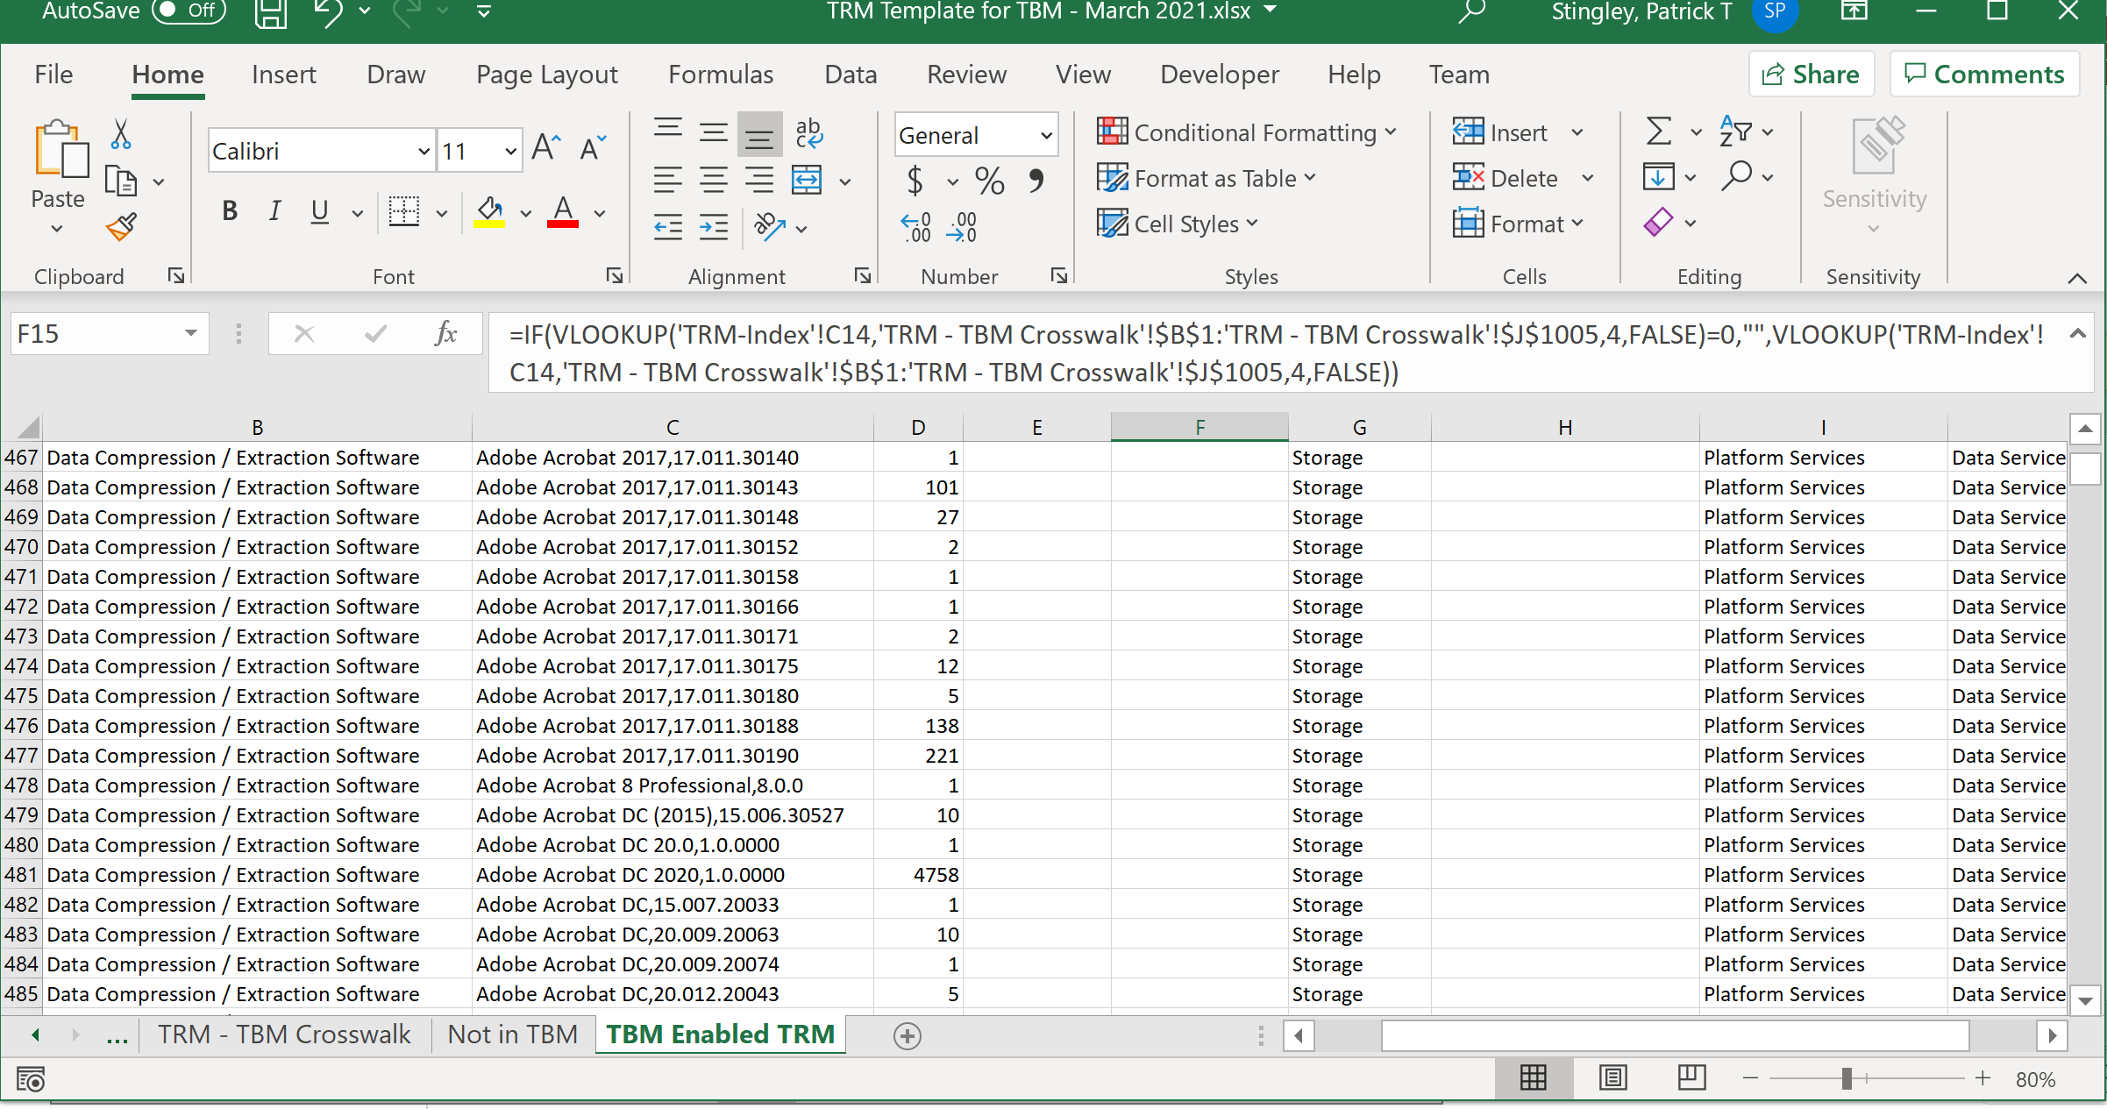
Step 3
Resulting in a TBM Enabled TRM
Patrick Stingley
Pstingley@BLM.gov
(202) 815-3550
Notes:
Again, the macros do their work and all of the products, with their FEAF categories and counts are now aligned with the TBM categories!

Slide 19
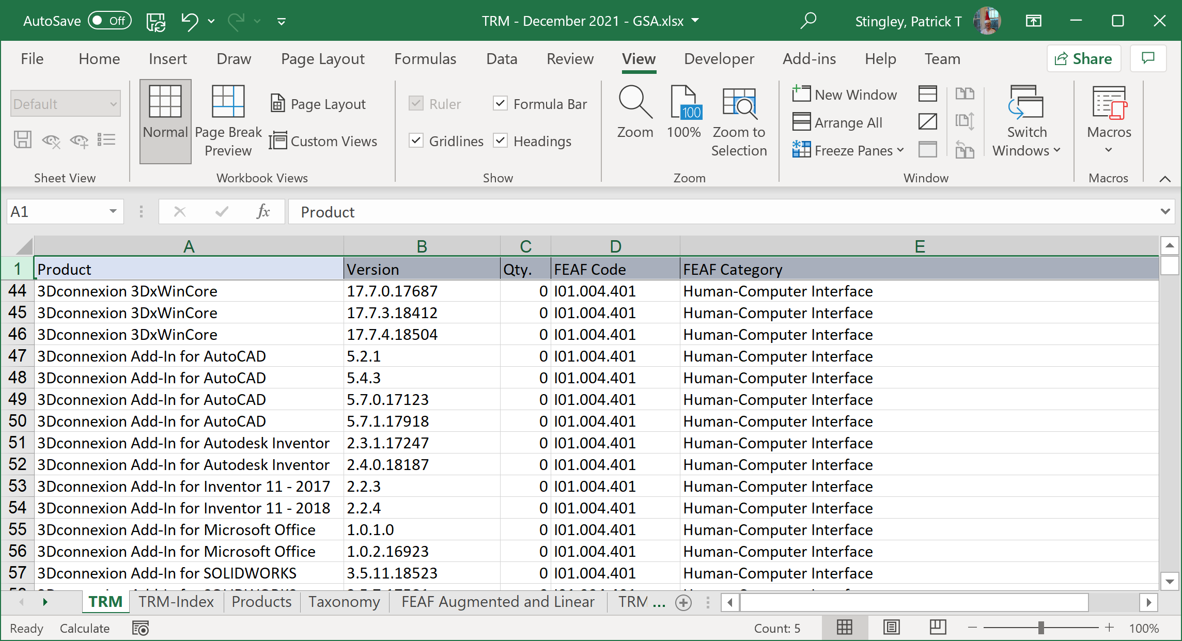
Results
TRM Tab shows all assets by FEAF category
Patrick Stingley
Pstingley@BLM.gov
(202) 815-3550
Notes:
Again, the macros do their work and all of the products, with their FEAF categories and counts are now aligned with the TBM categories!

Slide 20
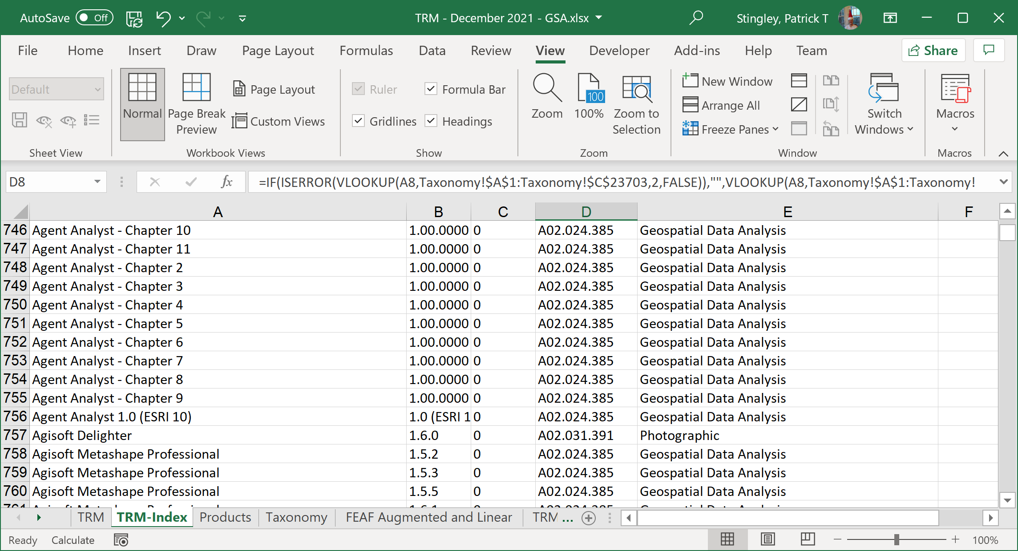
Results
TRM Index Tab contains macros to do aligments
Patrick Stingley
Pstingley@BLM.gov
(202) 815-3550
Notes:
Again, the macros do their work and all of the products, with their FEAF categories and counts are now aligned with the TBM categories!

Slide 21
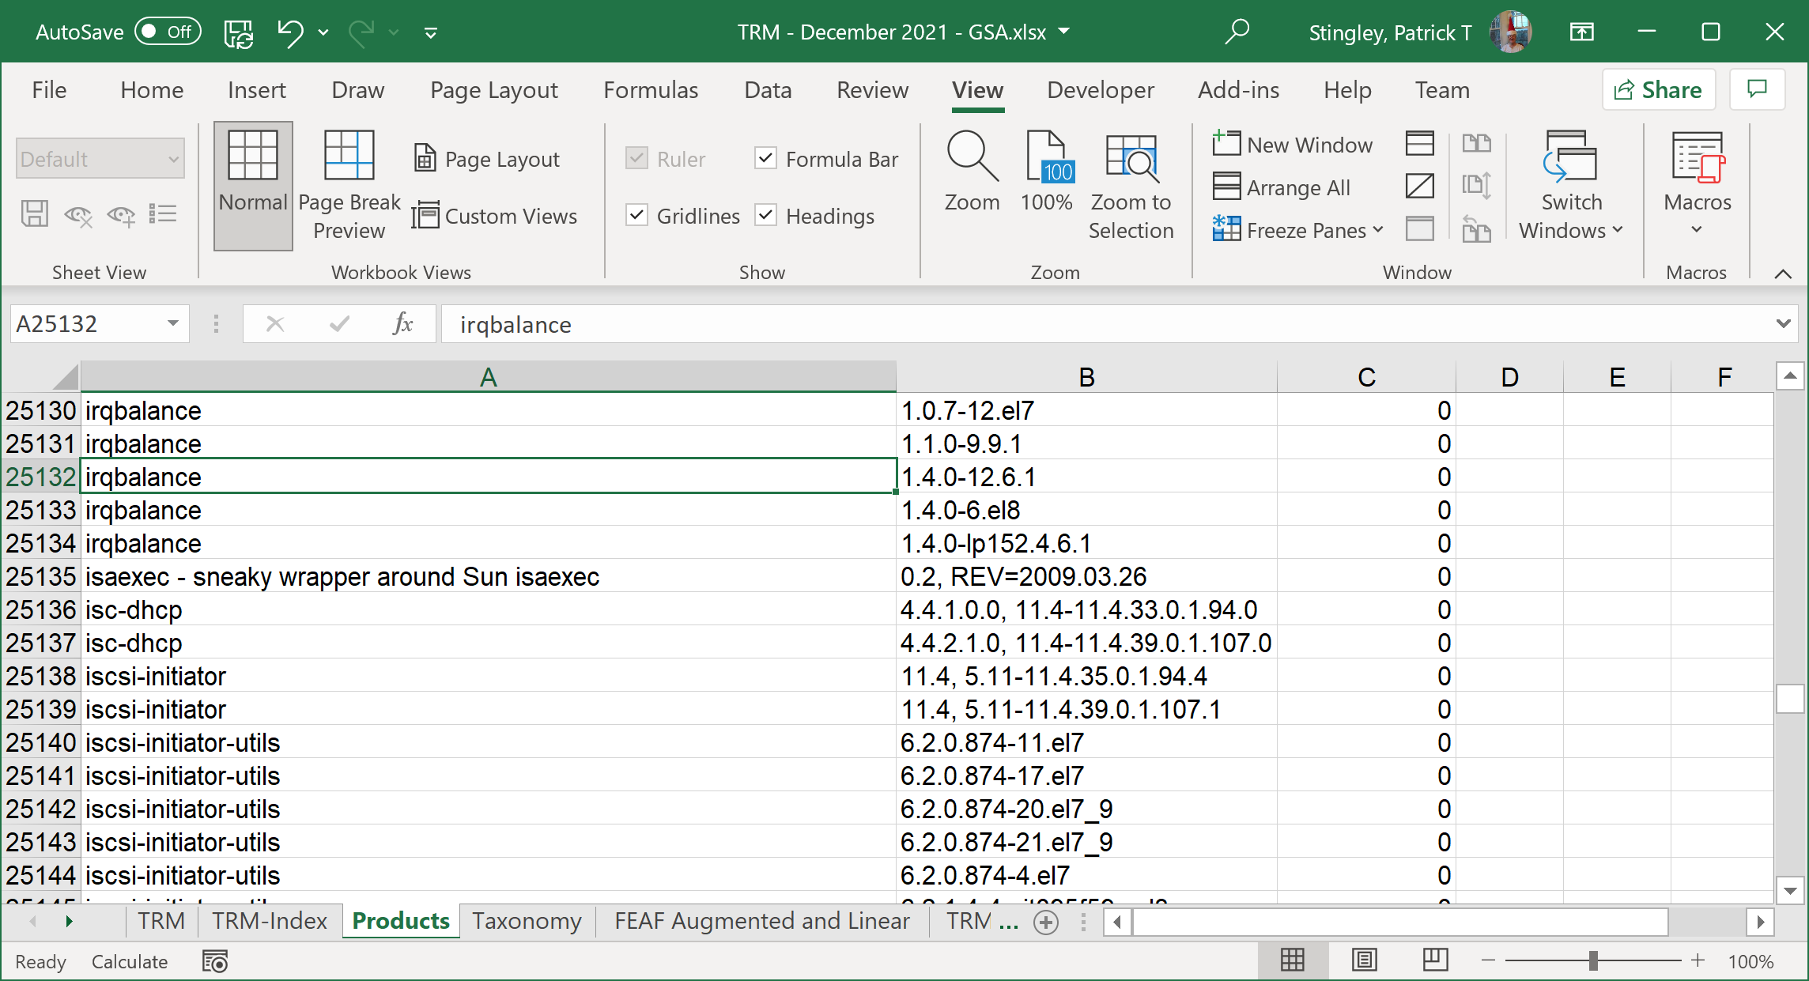
Results
Products Tab – Paste products and counts here
Patrick Stingley
Pstingley@BLM.gov
(202) 815-3550
Notes:
Again, the macros do their work and all of the products, with their FEAF categories and counts are now aligned with the TBM categories!

Slide 22
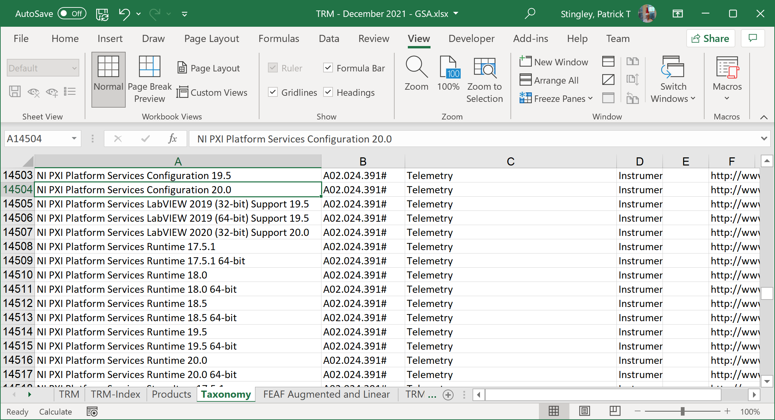
Results
Taxonomy Tab – Matches products with functions
Patrick Stingley
Pstingley@BLM.gov
(202) 815-3550
Notes:
Again, the macros do their work and all of the products, with their FEAF categories and counts are now aligned with the TBM categories!

Slide 23
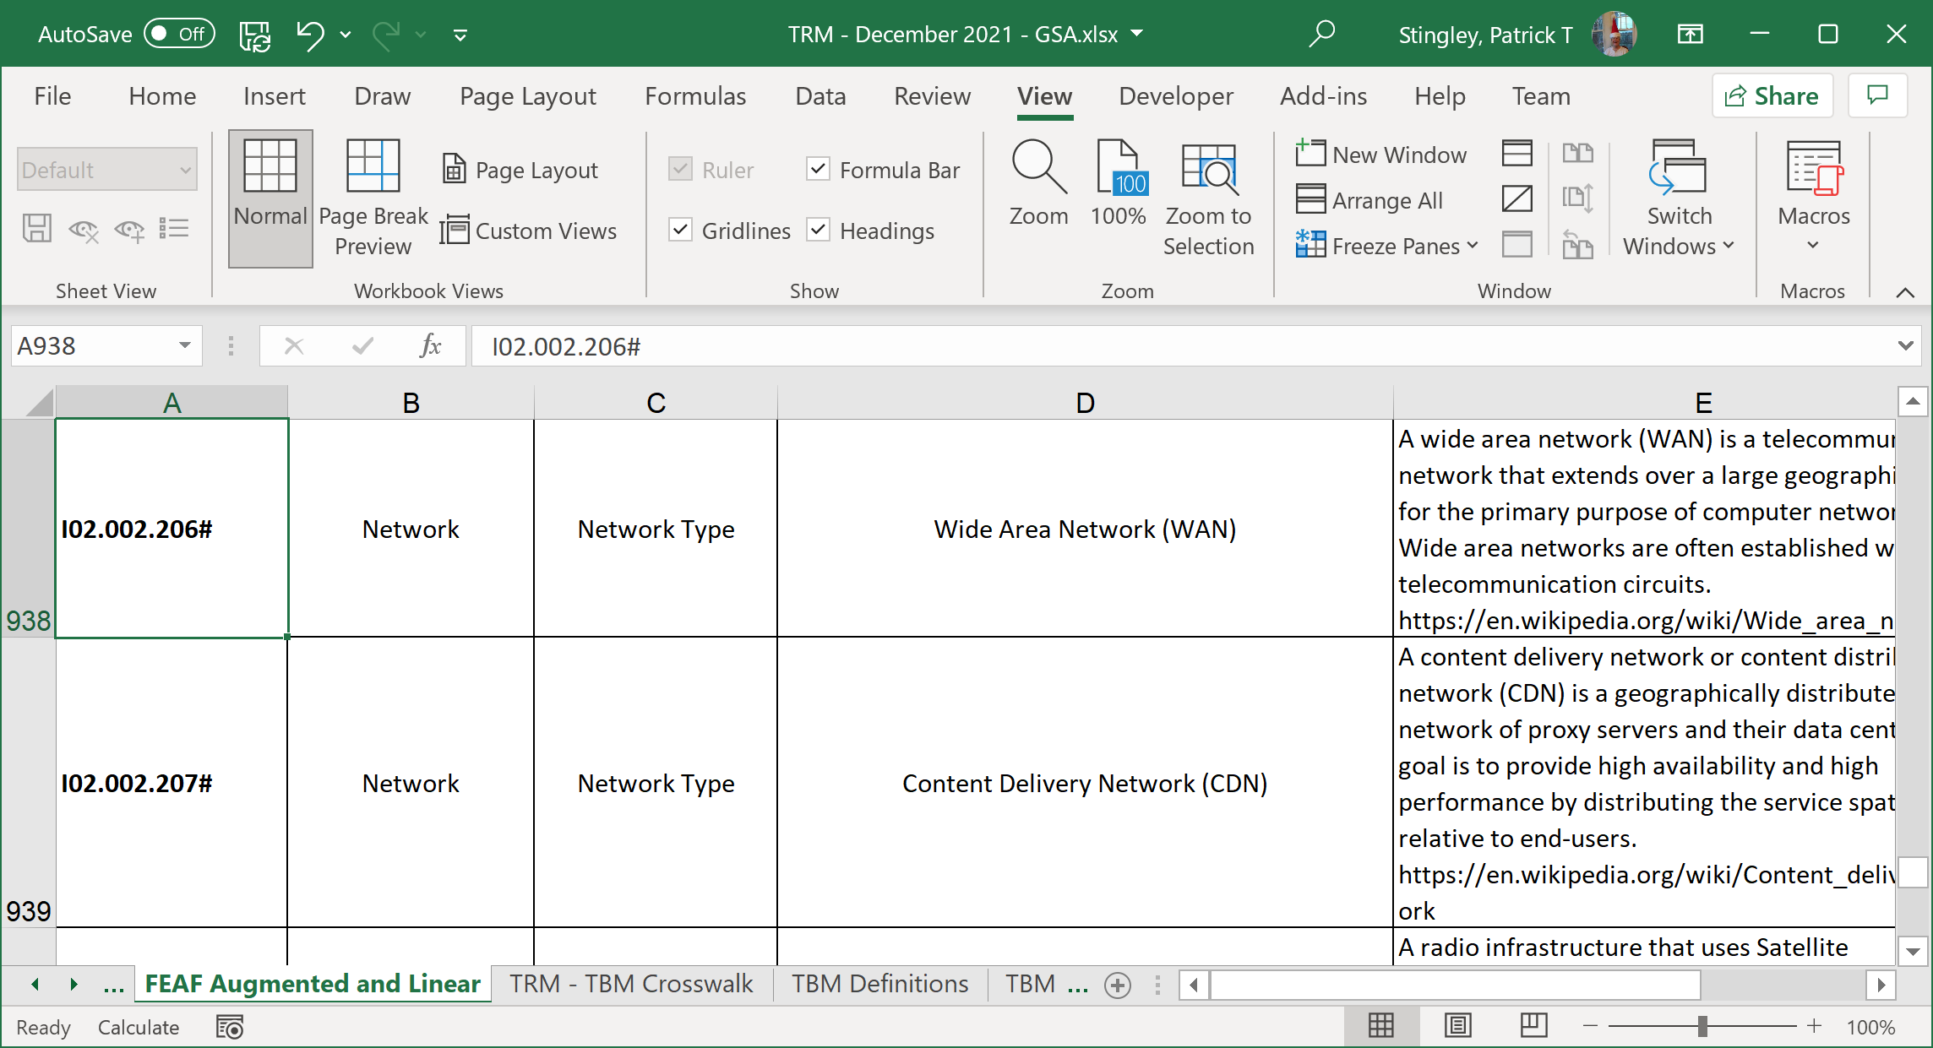
Results
FEAF Linear – Augmented FEAF and Definitions
Patrick Stingley
Pstingley@BLM.gov
(202) 815-3550
Notes:
Again, the macros do their work and all of the products, with their FEAF categories and counts are now aligned with the TBM categories!

Slide 24
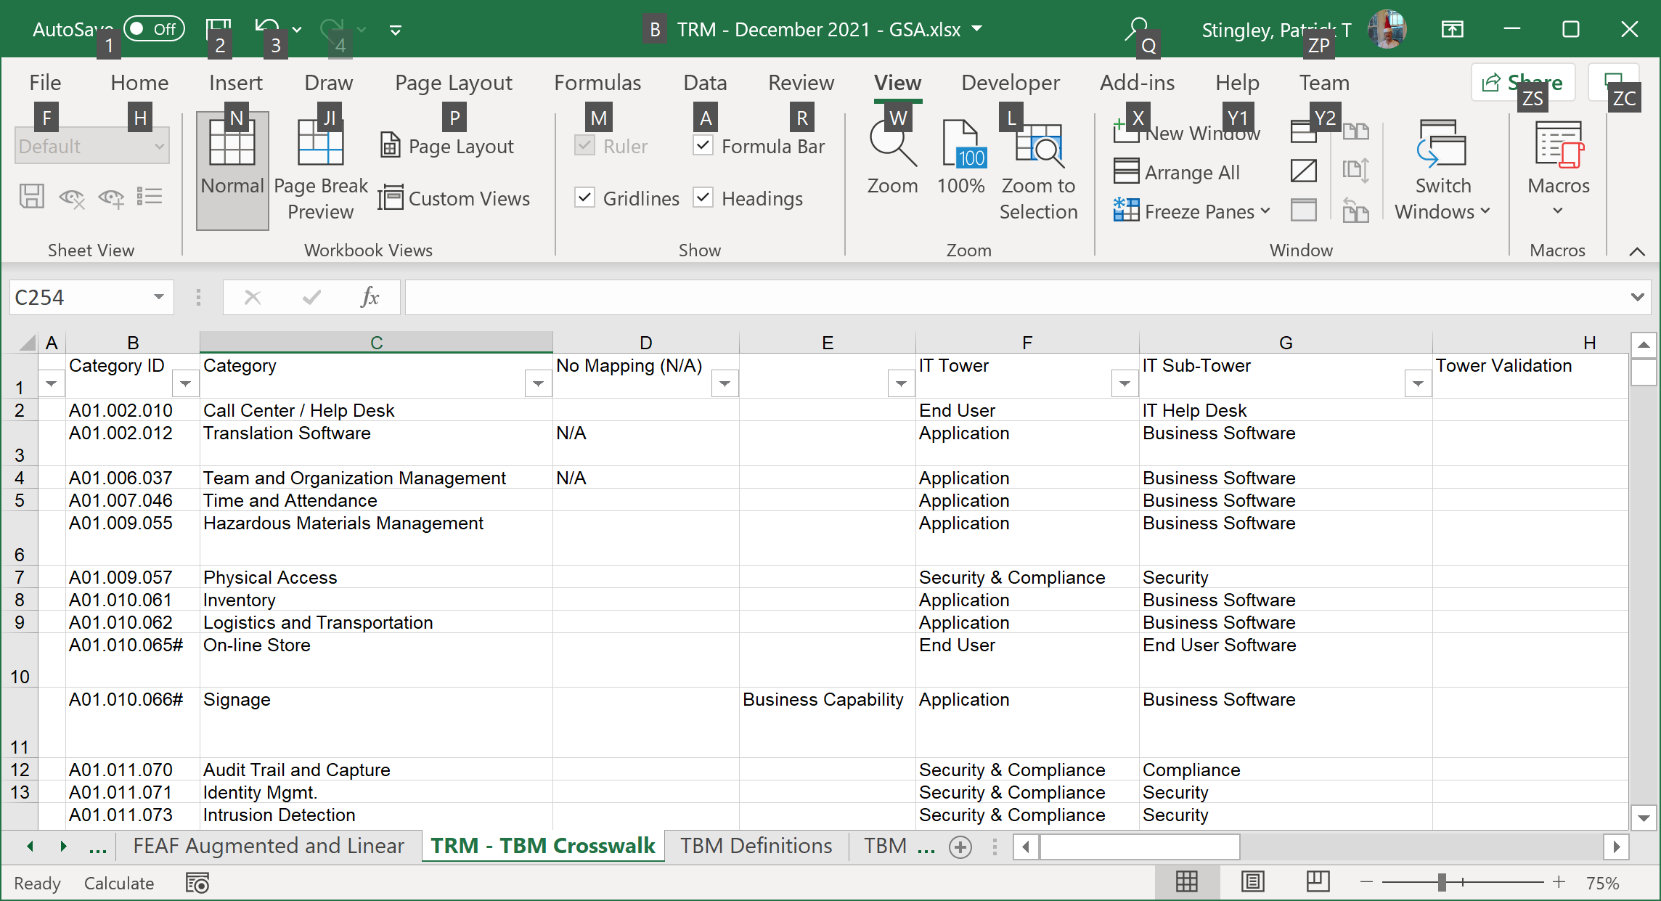
Results
TRM – TBM Crosswalk – Align the taxonomies
Patrick Stingley
Pstingley@BLM.gov
(202) 815-3550
Notes:
Again, the macros do their work and all of the products, with their FEAF categories and counts are now aligned with the TBM categories!

Slide 25
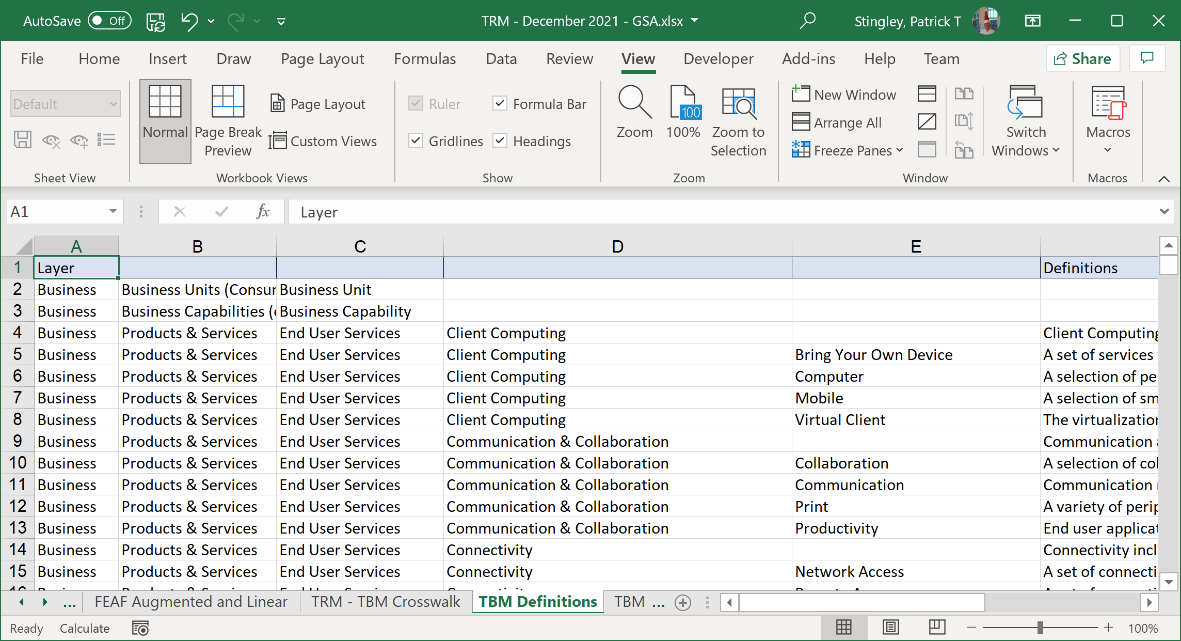
Results
TBM Definitions – searchable definitions
Patrick Stingley
Pstingley@BLM.gov
(202) 815-3550
Notes:
Again, the macros do their work and all of the products, with their FEAF categories and counts are now aligned with the TBM categories!

Slide 26
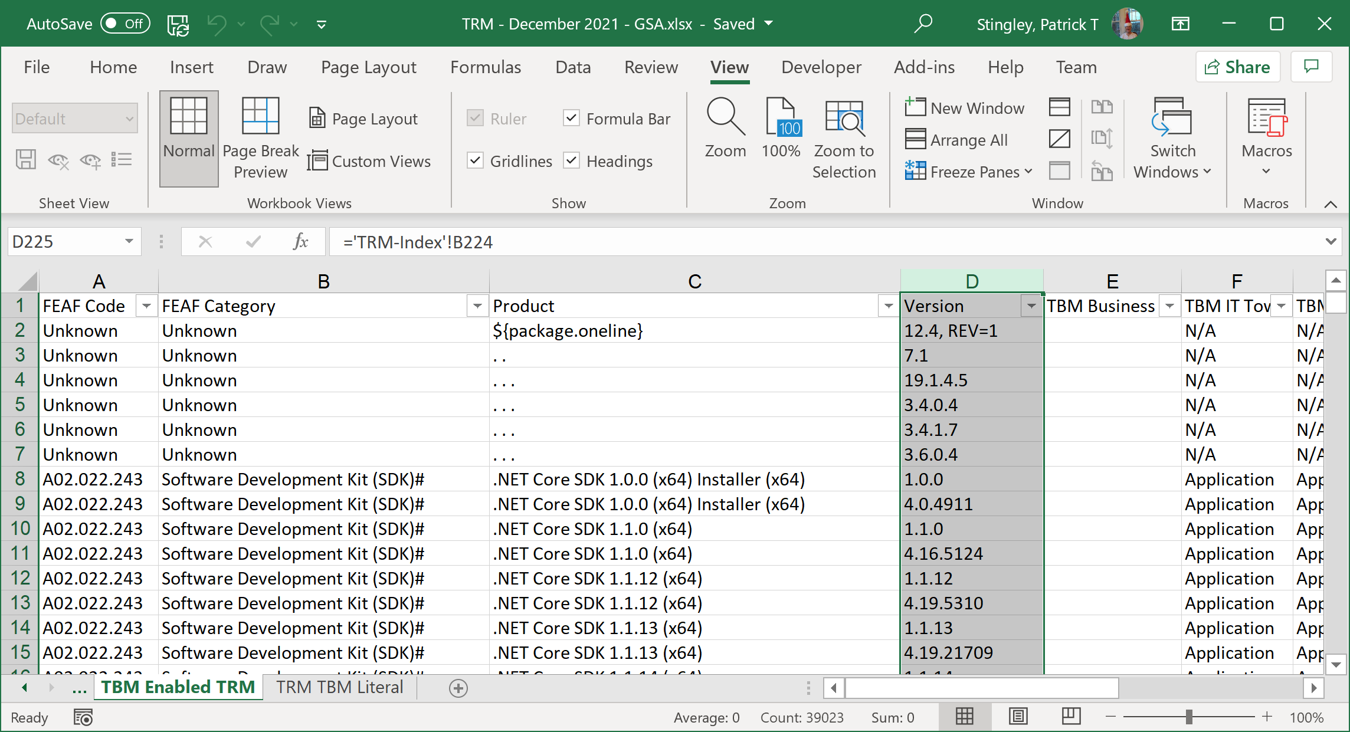
Results
TBM Enabled TRM – Shows TBM alignment
Patrick Stingley
Pstingley@BLM.gov
(202) 815-3550
Notes:
Again, the macros do their work and all of the products, with their FEAF categories and counts are now aligned with the TBM categories!

Slide 27
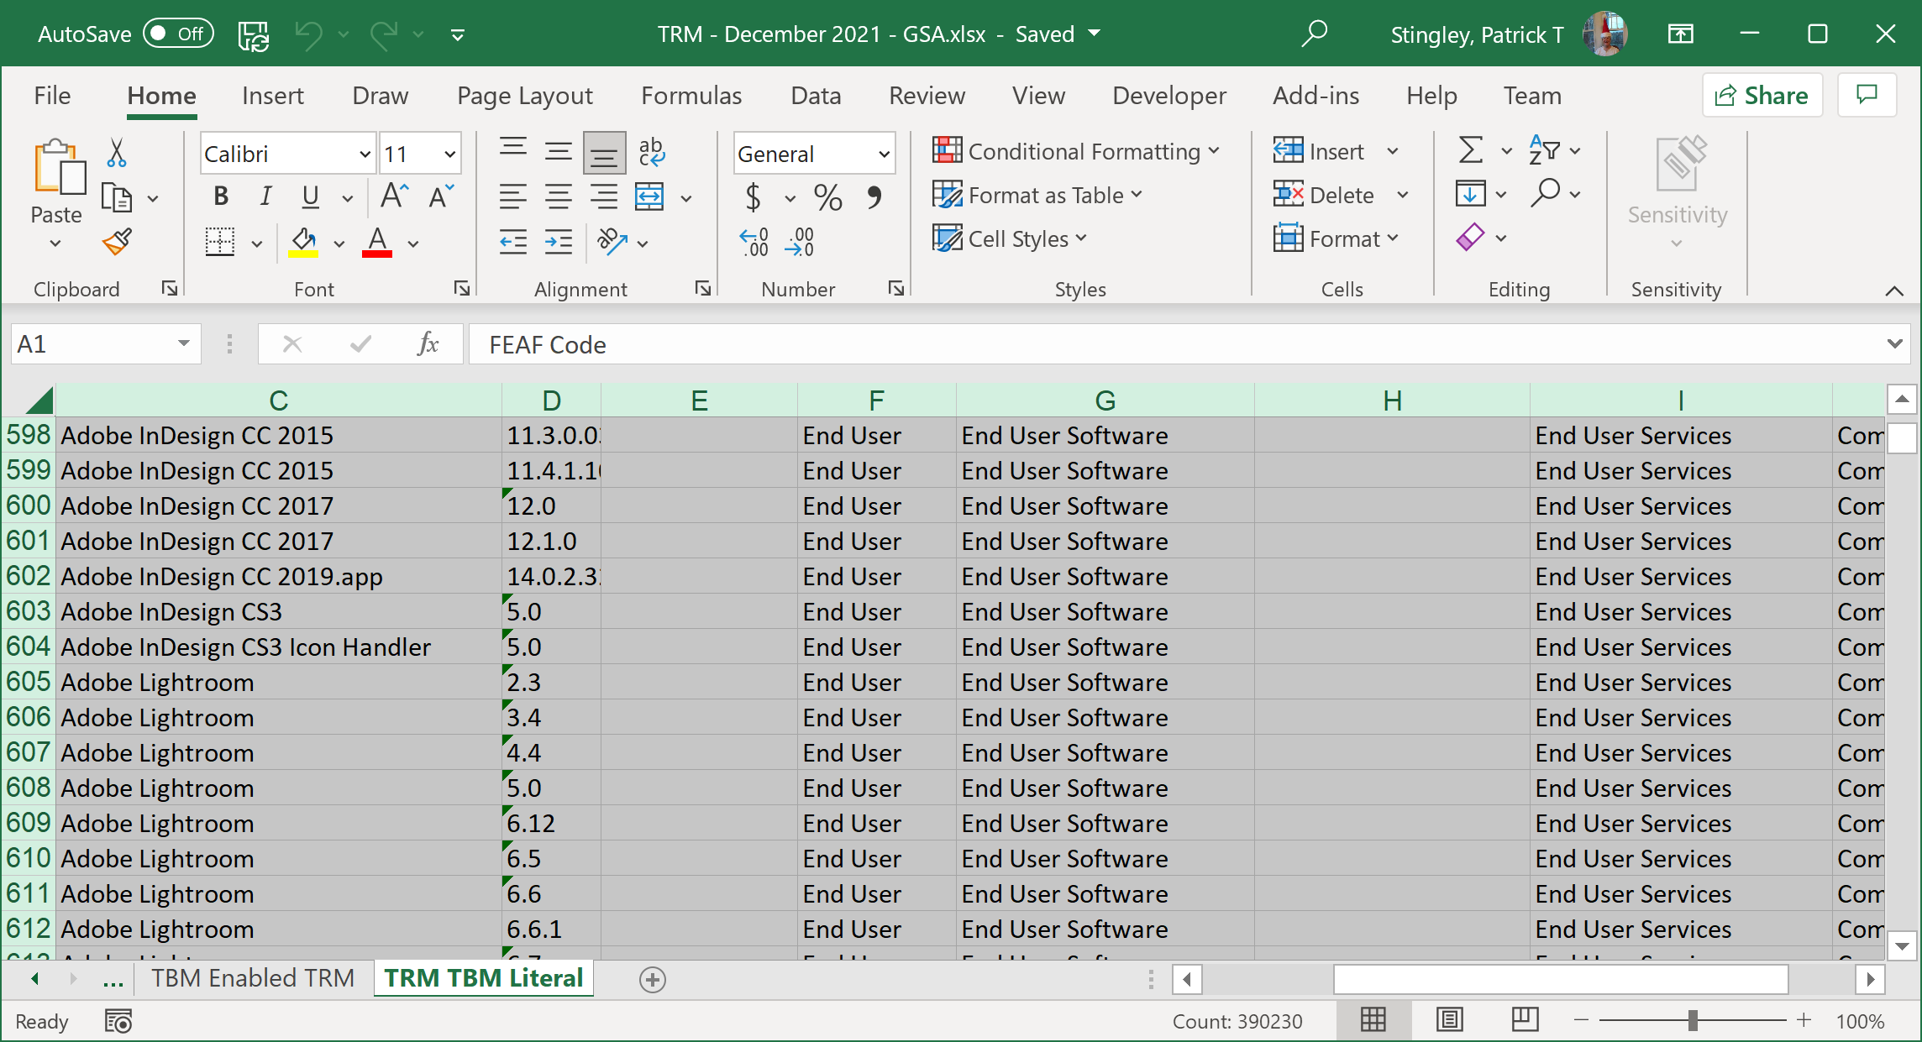
Results
TRM TBM Literal – Sortable TBM based TRM
Patrick Stingley
Pstingley@BLM.gov
(202) 815-3550
Notes:
Again, the macros do their work and all of the products, with their FEAF categories and counts are now aligned with the TBM categories!

Slide 28
Demo
Patrick Stingley
Pstingley@BLM.gov
(202) 815-3550

Slide 29
Questions?
Patrick Stingley
Pstingley@BLM.gov
(202) 815-3550

Slide 30

Contact Information:
Patrick Stingley
Pstingley@blm.gov
(202) 815-3550
Patrick Stingley
Pstingley@BLM.gov
(202) 815-3550

